Slide 1

Introduction to Bioinformatics
INSTITUTE OF NEUROSCIENCE
中国科学院神经科学研究所
Jun Yan
Laboratory of Network Computation
Institute of Neuroscience
Chinese Academy of Sciences

Slide 2
什么是生物信息学？
80年代末随着人类基因组计划启动而兴起的一门新兴交叉学科
生命科学中的信息科学
基因组相关信息的快速增长 (方法与技术需求)
新药开发等 (企业需求)
生物信息学 (Bioinformatics) 与计算生物学 (Computational Biology)

Slide 3

生物学在20世纪末经历的最大变革是：生物成为了一门信息科学。
－－Eric Lander

Slide 4
组学(-omics)时代的到来
基因组、转录组、蛋白组、代谢组
必须采用统计方法才能有效地处理、整合、挖掘高通量、大规模生物数据（序列数据、表达数据、图像数据等等）。

Slide 5
Human Genome Project

Slide 6
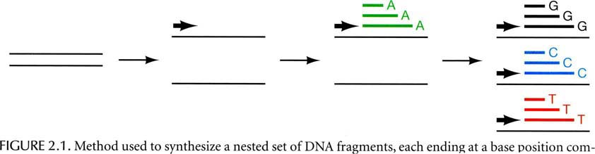
DNA sequencing

Slide 7
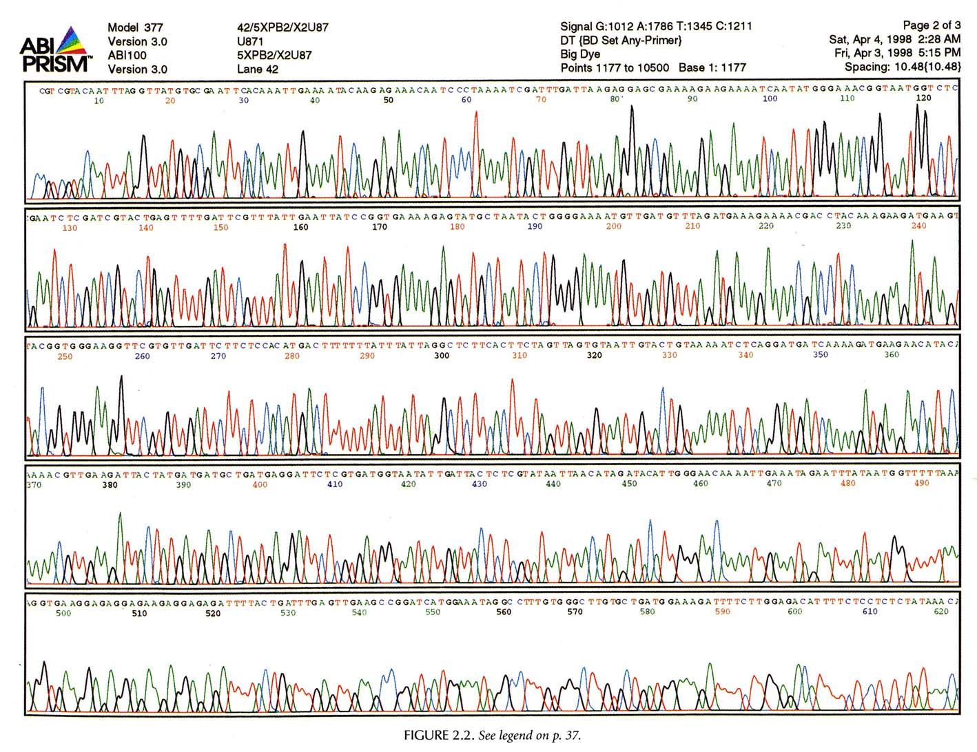

Slide 8
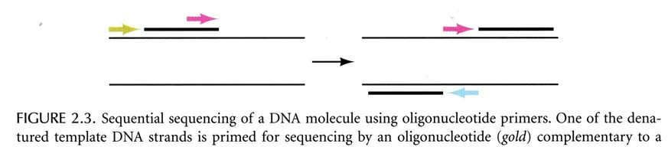

Slide 9
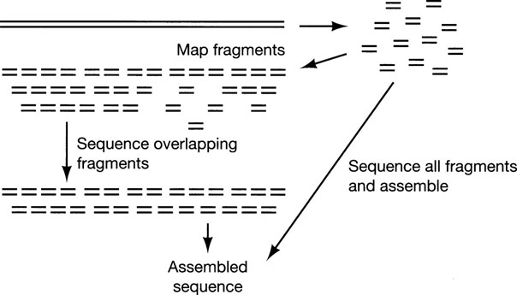
Shotgun sequencing

Slide 10
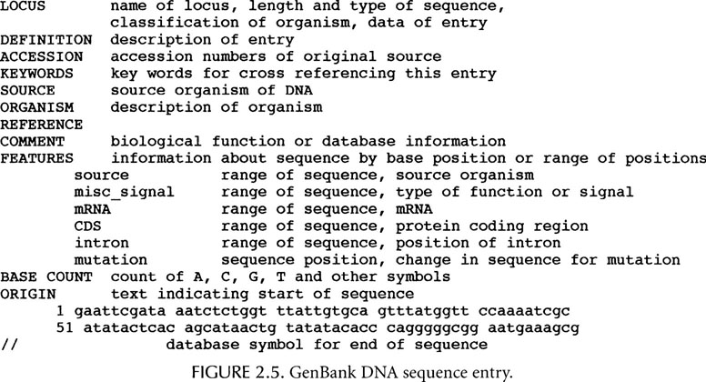
GenBank DNA sequence

Slide 11
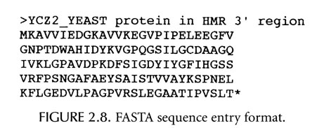
FASTA sequence format

Slide 12
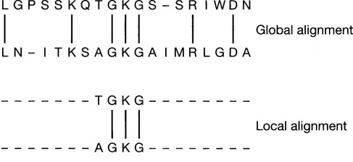
Sequence Alignment

Slide 13
Global alignment
In global alignment, an attempt is made to align the entire sequence using all sequence characters.
It is suitable for sequences that are quite similar and approximately the same length.

Slide 14
Local alignment
In local alignment, stretches of sequence with highest density of matches are aligned, generating “islands of matches”.
It is suitable for sequences that are similar along some of their lengths but dissimilar in others, sequences differed in length or share a conserved domain.

Slide 15
Methods for pair-wise alignment
Dot matrix analysis
Dynamic programming algorithm
Word or k-tuple methods such as FASTA and BLAST.

Slide 16
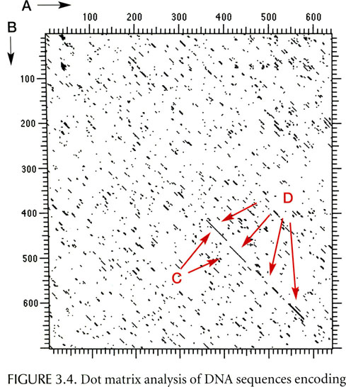
Dot matrix to compare two sequences

Slide 17
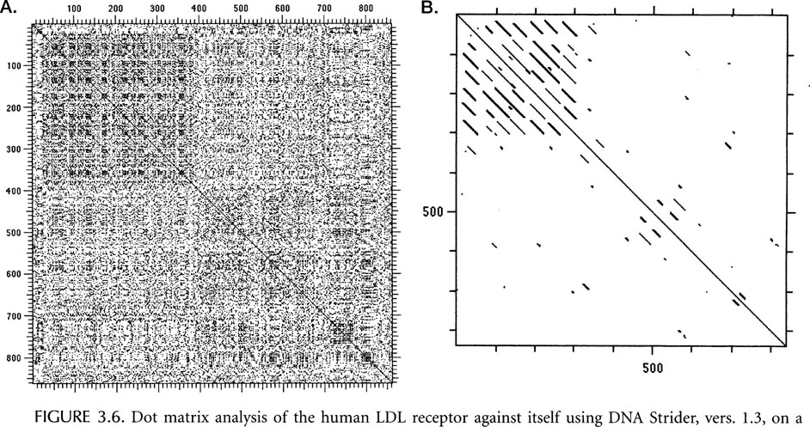
Dot matrix to detect repeats

Slide 18
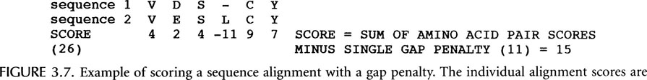
Example of Scores

Slide 19
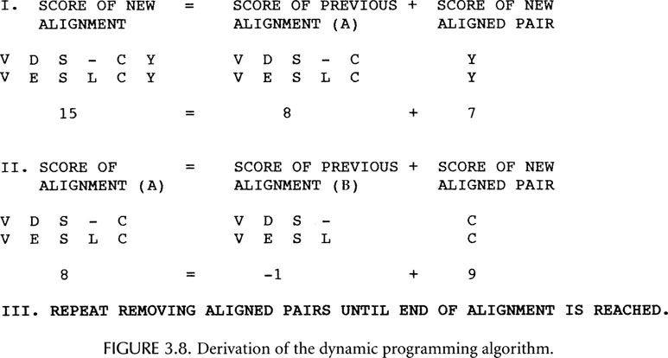

Slide 20
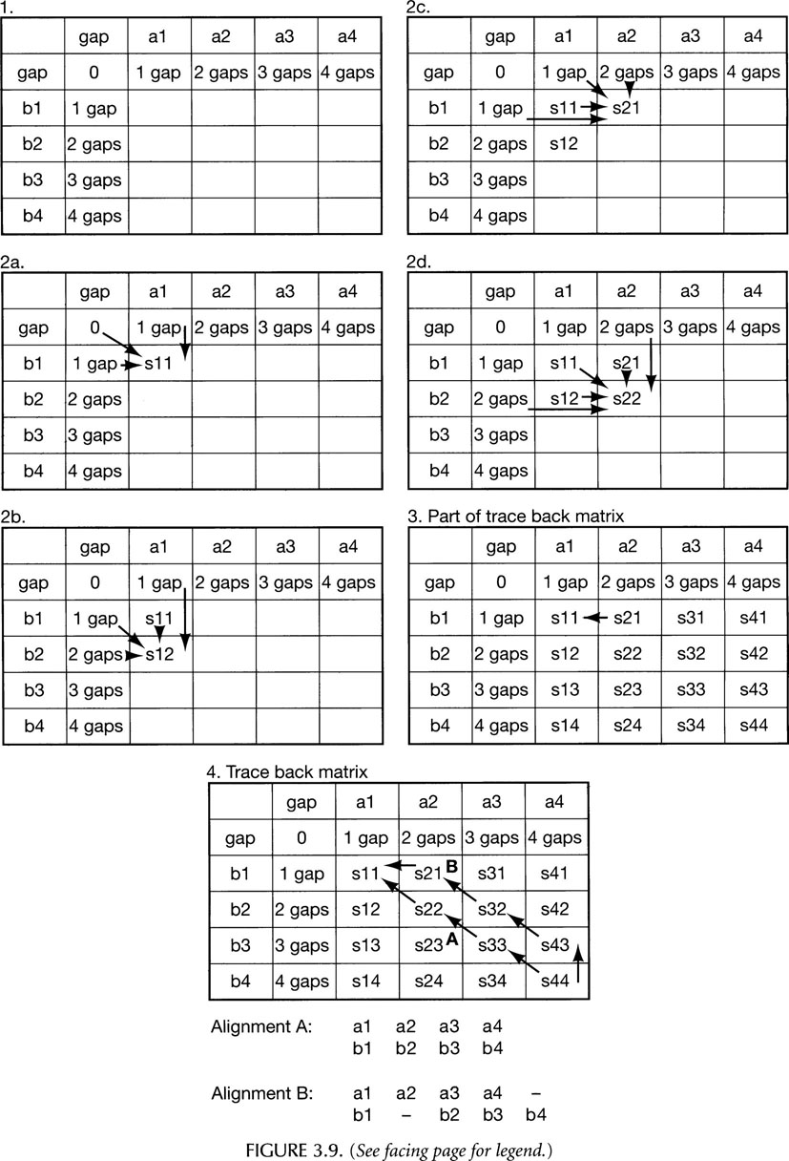

Slide 21
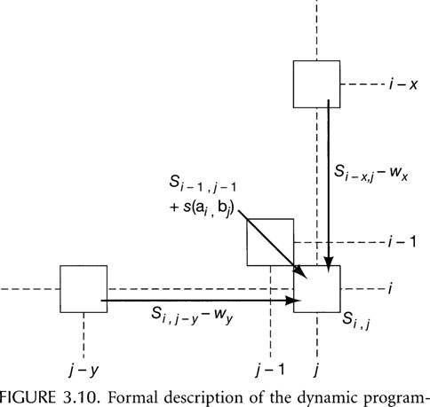
Description of Dynamic Programming

Slide 22
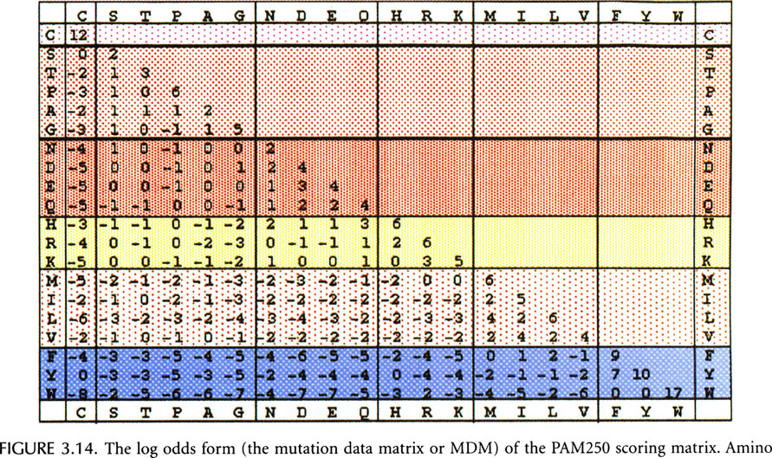
PAM scoring matrix

Slide 23
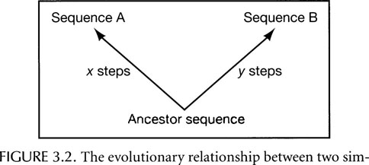

Slide 24
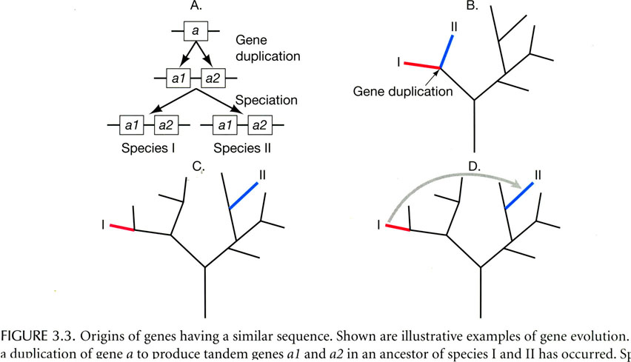
Gene Duplication and Speciation

Slide 25
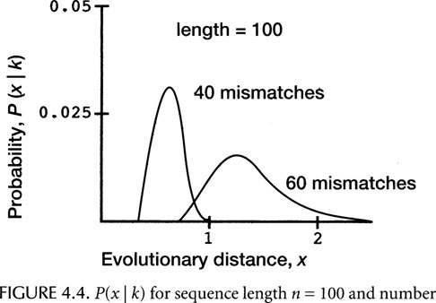

Slide 26
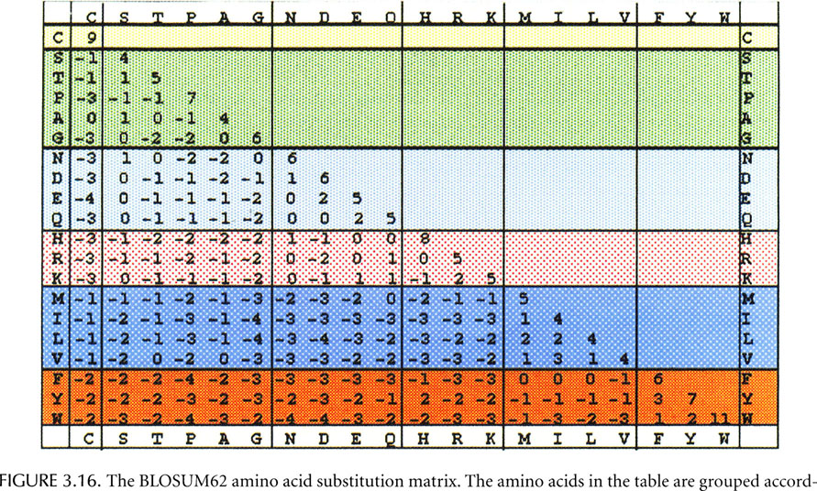
BLOSUM62 scoring matrix

Slide 27
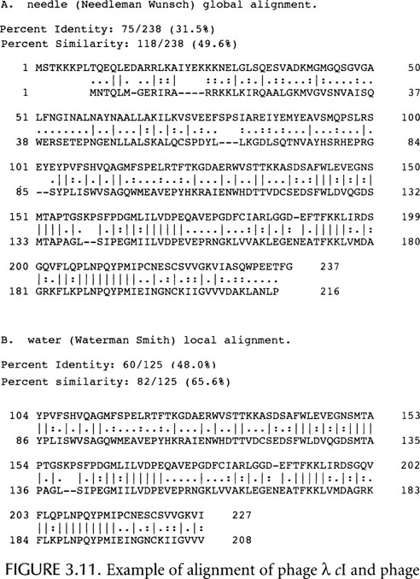

Slide 28
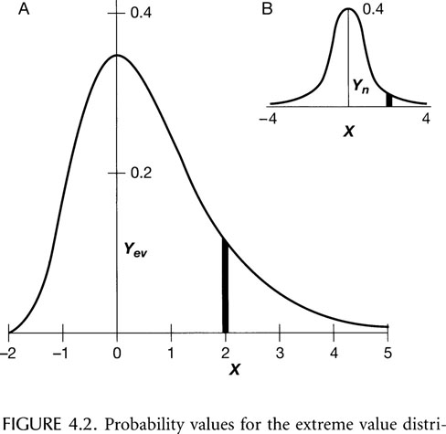
How to assess the significance of the alignment score?
Gumbel Extreme Value Distribution (EVD)

Slide 29
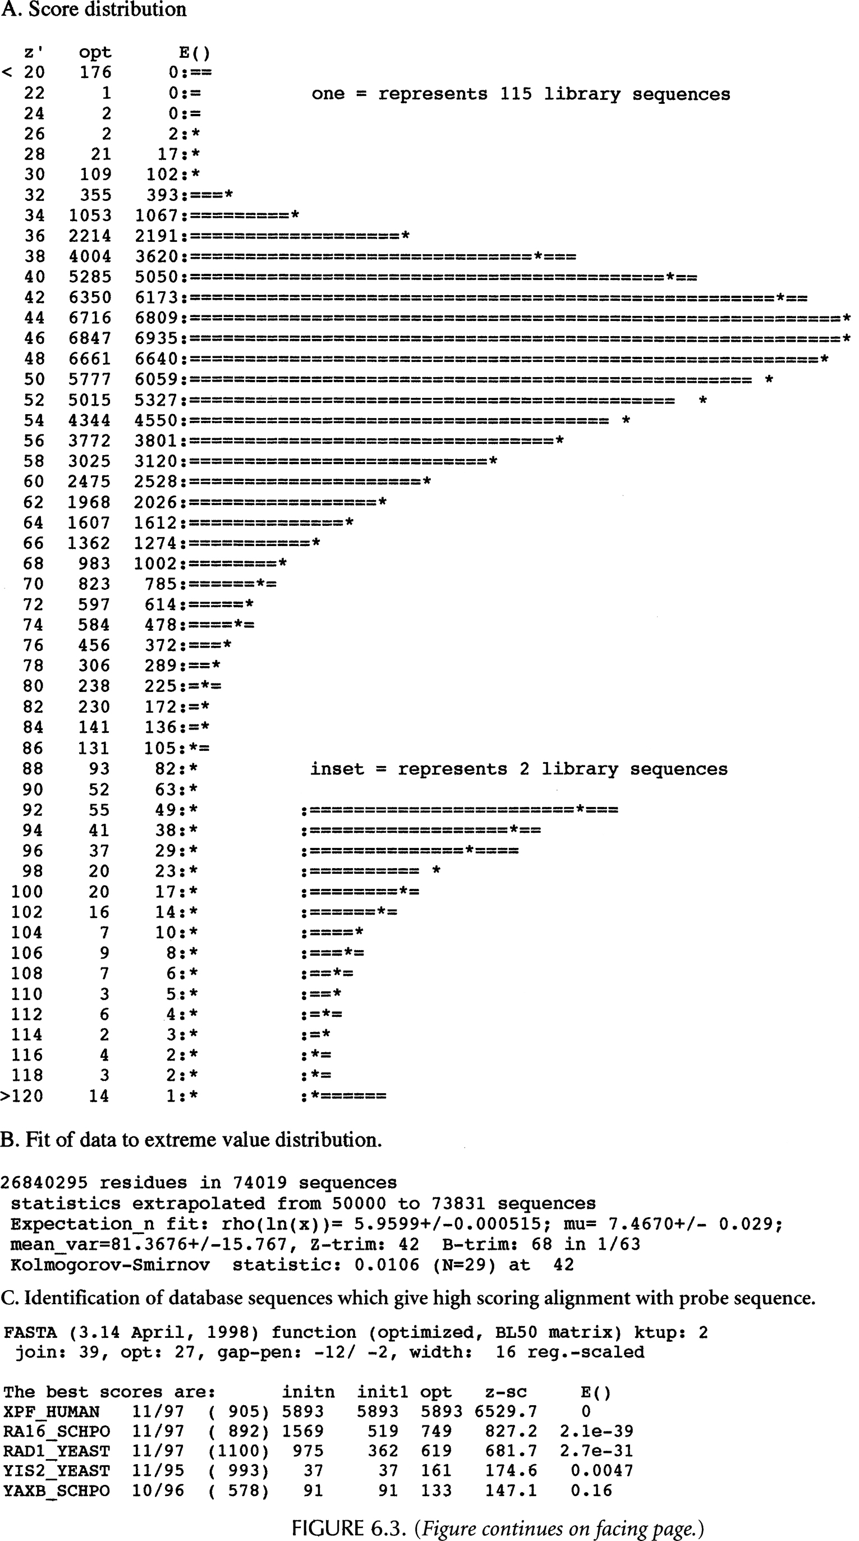

Slide 30
BLAST Basic Local Alignment Search Tool
分子数据库检索

Slide 31
BLAST 流程
W为字长 e.g., 2
T为阈值（score) e.g., 8
QL
LN
NF
FS
SA
AG
GW
QL=11, QM=9, HL=8, ZL=9
LN=9, LB=8
NF=12, AF=8, NY=8, DF=10,…
序列库
w
QLNFSAGW
…
T
…
BLAST可搜索库
...
Hit extension
（击中延伸）
...
Neighbourhood Word
生成输出文件
统计计算
根据阈值决定终止点
Notes:
True match alignments are very likely to contain somewhere within them a short stretch of identities or very high scoring matches.
One of several programs used by researchers to search for similarities between newlyuncovered DNA or protein sequences and those previously discovered, BLAST has the distinct advantages of being quick and easy to use. It also has capabilities that allow the program to pick out statistically significant sequence similarities.
The programs, blastn and blastp, offer fully gapped alignments. blastx and tblastn have 'in-frame' gapped alignments and use sum statistics to link alignments from different frames. tblastx provides only ungapped alignments

Slide 32
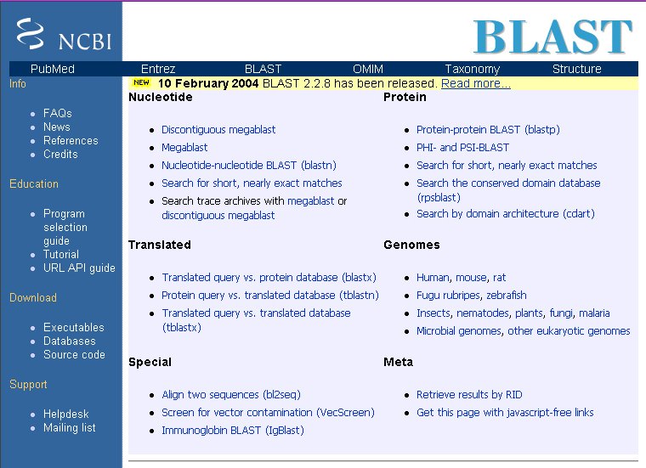
http://www.ncbi.nlm.nih.gov/BLAST
Notes:
Request ID

Slide 33

新版界面

Slide 34
BLAST系列程序选择流程
查询序列
蛋白质序列？
蛋白质数据库？
否
否
是
是
蛋白质数据库？
否
否
数据库翻译？
是
是
blastp
tblastn
blastx
tblastx
blastn

Slide 35
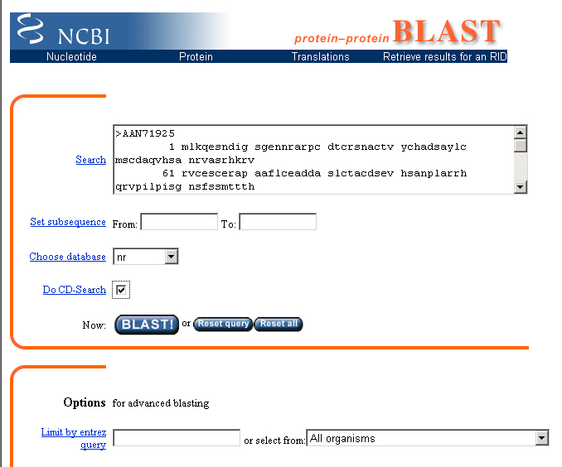
BLASTp

Slide 36
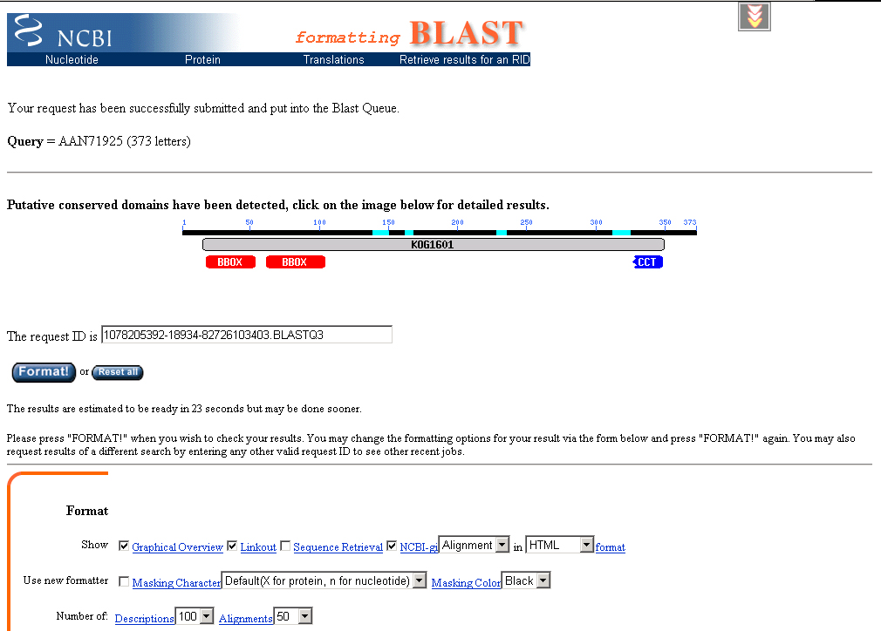
BLAST ID

Slide 37
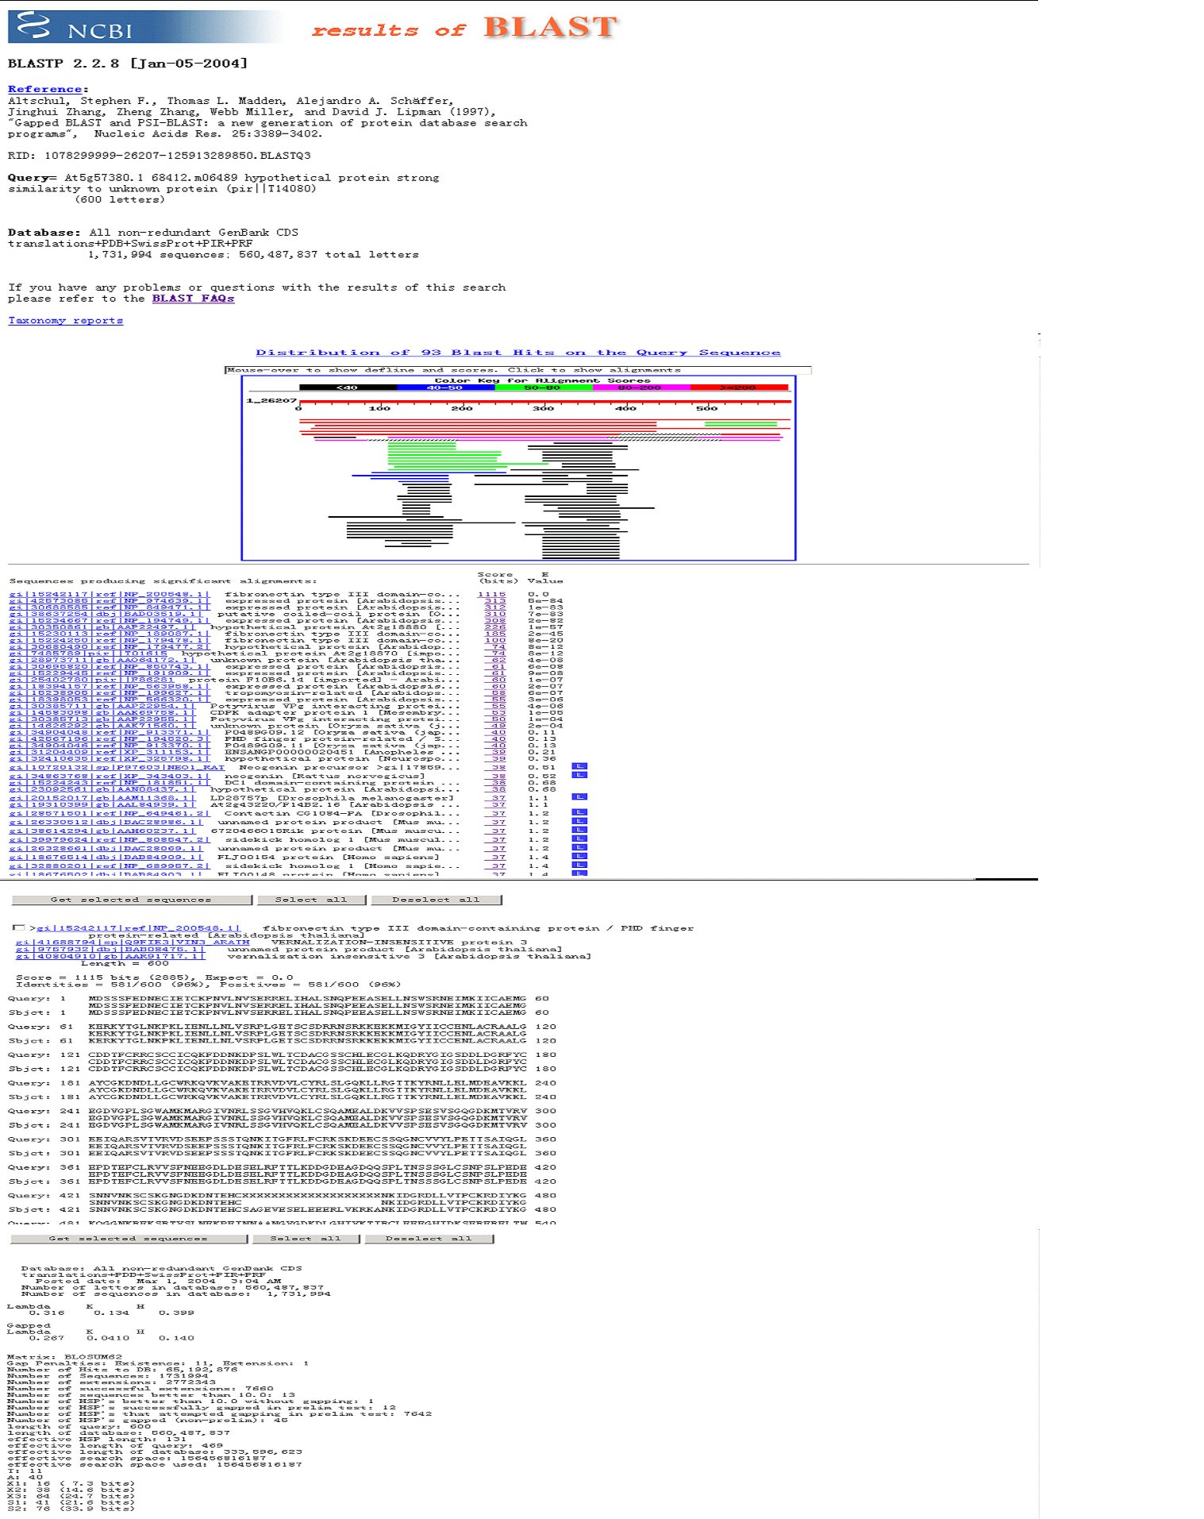
BLAST 结果 (1 - 5)
1
2
3
4
5

Slide 38
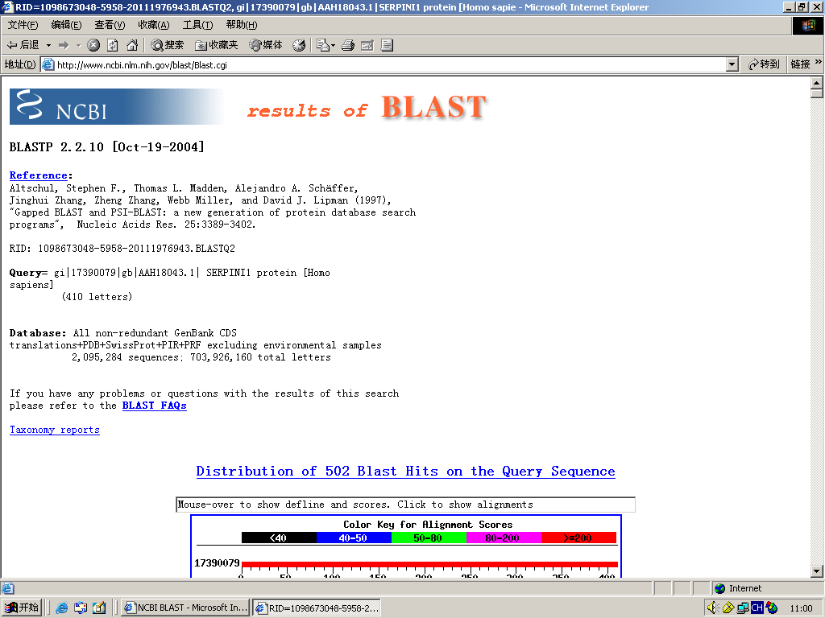
BLAST 结果 (1)

Slide 39
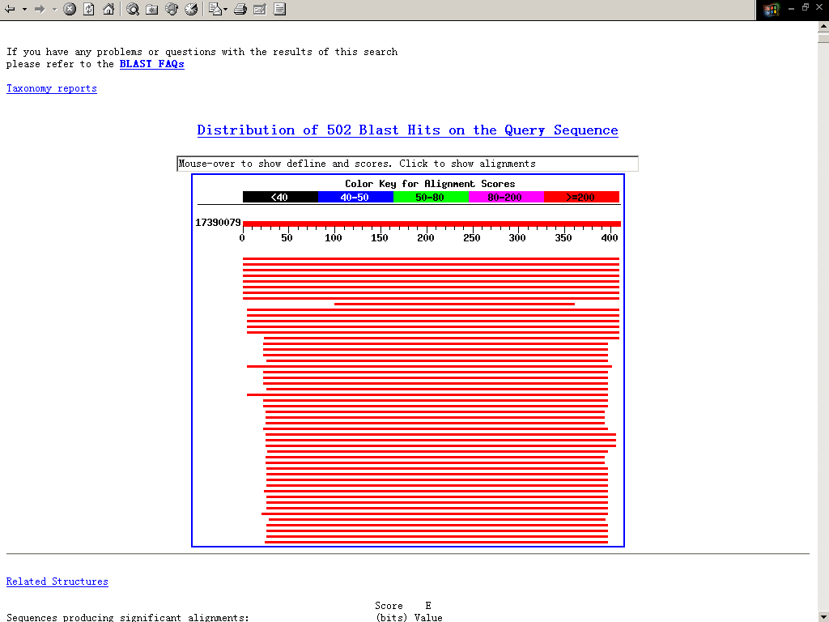
BLAST 结果 (2)

Slide 40
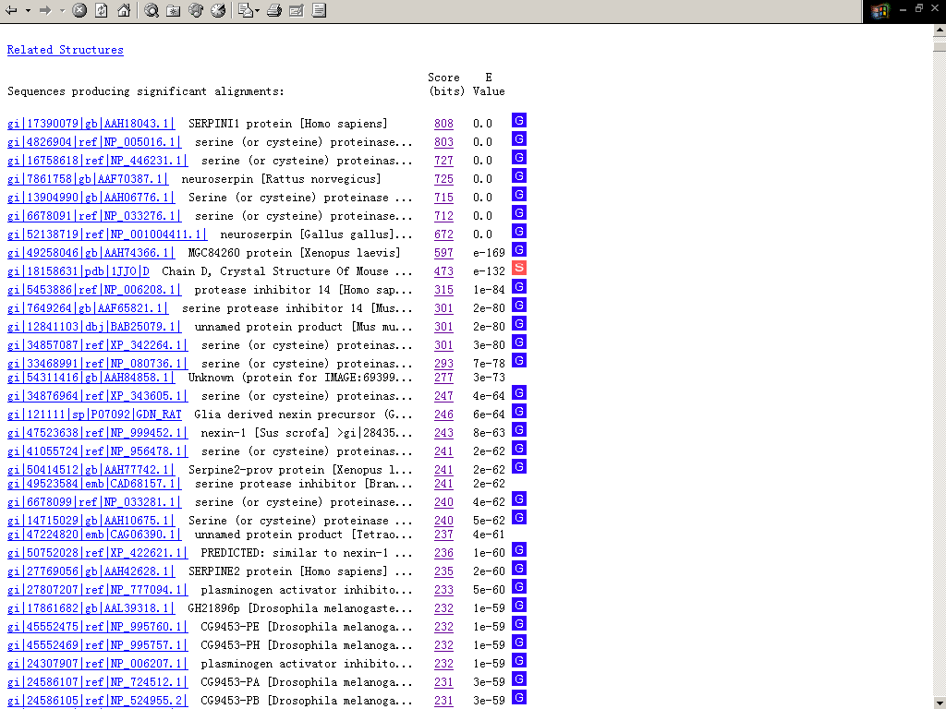
BLAST 结果 (3)

Slide 41
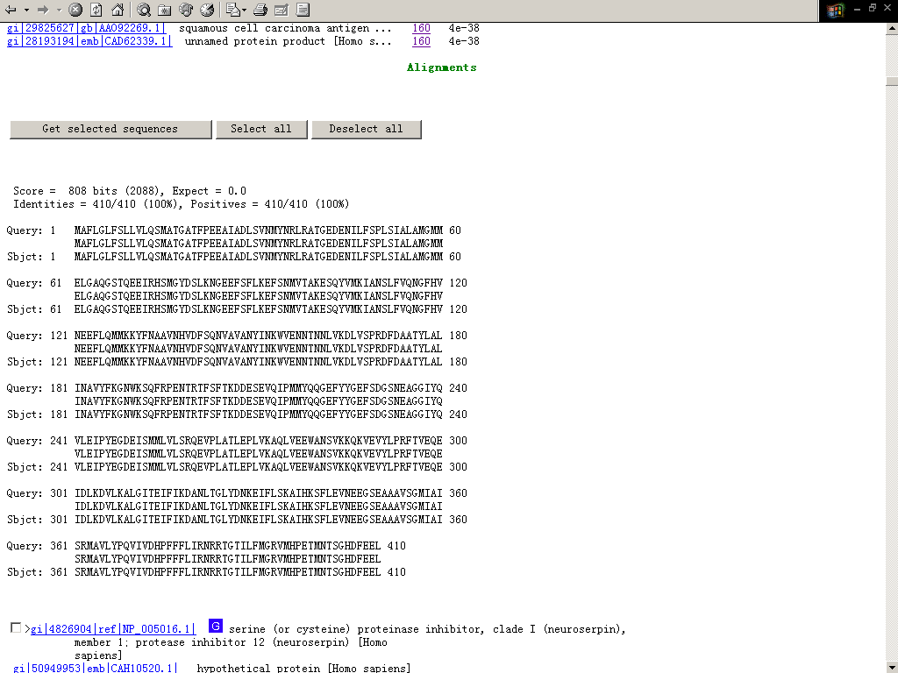
BLAST 结果 (4)

Slide 42
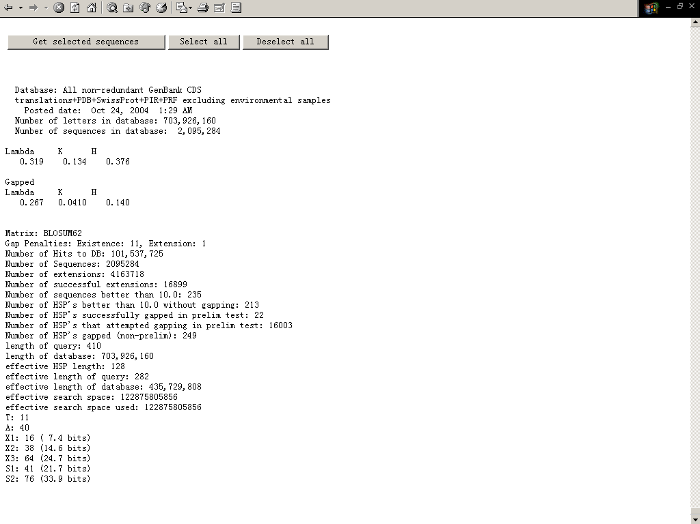
BLAST 结果 (5)

Slide 43
分值和E值
BLASTP 2.2.14 [May-07-2006]
Reference: Altschul, Stephen F., Thomas L. Madden, Alejandro A. Schäffer,
Jinghui Zhang, Zheng Zhang, Webb Miller, and David J. Lipman
(1997), "Gapped BLAST and PSI-BLAST: a new generation of
protein database search programs", Nucleic Acids Res. 25:3389-3402.
RID: 1157436303-6611-9612772342.BLASTQ4
Database: All non-redundant GenBank CDS
translations+PDB+SwissProt+PIR+PRF excluding environmental samples
3,946,334 sequences; 1,357,962,904 total letters
Query=
Length=137
Distance tree of results
Score E
Sequences producing significant alignments: (Bits) Value
gi|16129916|ref|NP_416479.1| hypothetical protein b1970 [Esch... 278 4e-74
gi|110805940|ref|YP_689460.1| hypothetical protein SFV_2015 [... 275 3e-73
gi|15802403|ref|NP_288429.1| hypothetical protein Z3062 [Esch... 274 9e-73
gi|82776345|ref|YP_402694.1| hypothetical protein SDY_1038 [S... 204 9e-52
gi|16419612|gb|AAL20029.1| putative periplasmic or exported p... 201 6e-51
<以下内容已删除>

Slide 44
分值是衡量查询序列同击中序列间相似性的测度。分值越高，击中序列与查询序列越相似
E值是随机产生一个比所得分值高的击中序列的概率，即分值可靠性的测度。 E值越小, 击中序列越可靠
Notes:
The probability due to chance, that there is another alignment with a similarity greater than the given S score.

Slide 45
E值计算公式：
E = K · m · n · e ^{-λS}
K， 一个与目标序列相关的经验常数
λ ，与计分（分值）系统相关的经验常数
m，查询序列大小
n，所查询数据库大小
S，分值

Slide 46
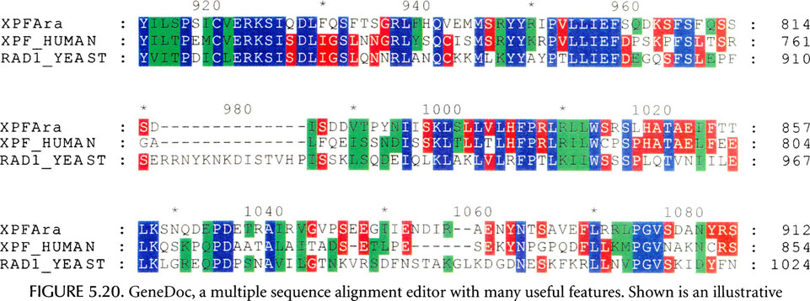
Multiple sequence alignment

Slide 47
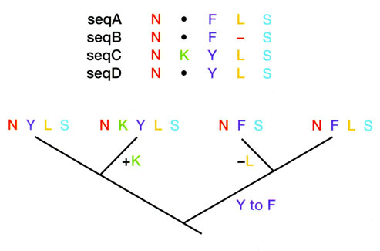
Global multiple sequence alignment

Slide 48
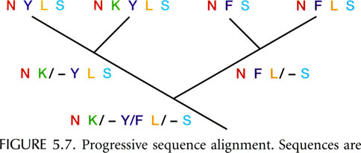
Progressive sequence alignment

Slide 49
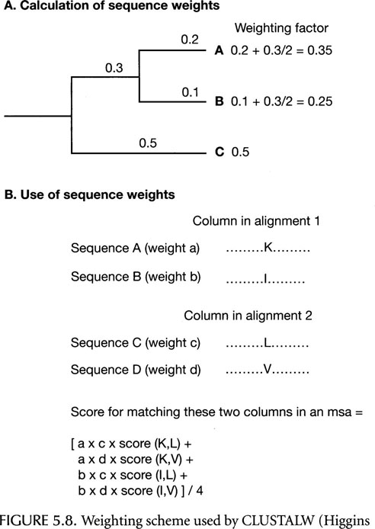
Progressive sequence alignment

Slide 50
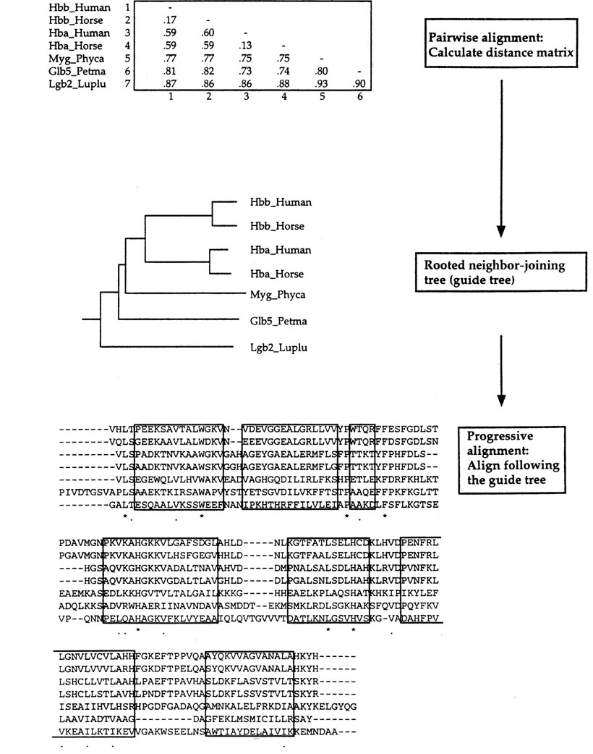
An example of CLUSTALW

Slide 51
Local Multiple Sequence Alignment
Align the most similar regions and ignore dissimilar regions.
Profile analysis identify highly conserved regions in a global alignment.
Block analysis identify substituted regions without gaps.
Pattern searching. These methods do not depend on first producing a global multiple sequence alignment.

Slide 52
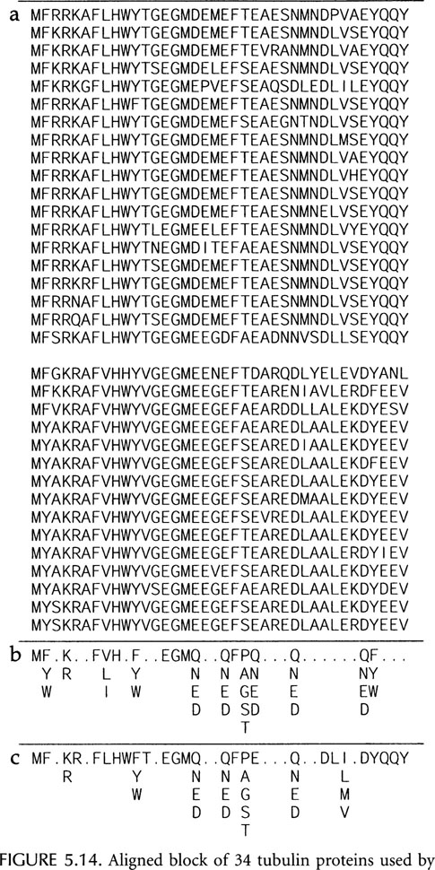
Block Analysis

Slide 53
Expectation maximization (EM) algorithm
EM is a two-stage process: (E & M).
An initial guess is made to the location of a variable sequence pattern.
The sequences are scanned for this pattern for possible matches.
The pattern is adjusted to provide better match to the sequences.
Repeat until no further changes.
Example: MEME (multiple EM for motif Elicitation)

Slide 54
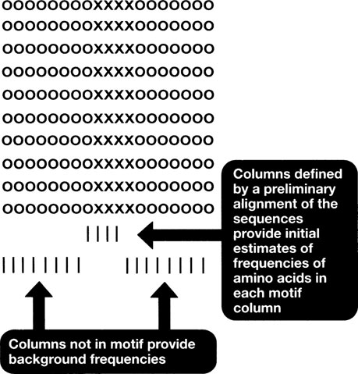
EM algorithm (Expectation Step)

Slide 55
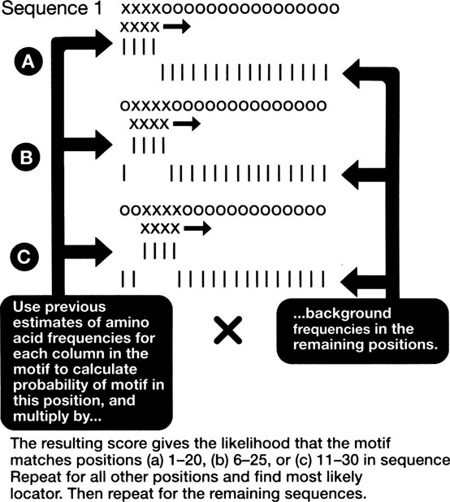
EM algorithm (Maximization Step)

Slide 56
Gibbs Sampler
A trial pattern is identified in all but one of the sequences.
The left-out sequence is evaluated for probable locations of the pattern.
The pattern is then updated on the basis of this information.
Repeat until no further change in the pattern.

Slide 57
Hidden Markov Model (HMM)
HMM is a statistical model that considers all possible matches, mismatches, and gaps to generate an alignment of sequences.
HMM can be trained by a given set of sequences.
The trained HMM produces an alignment.
Trained HMM can be used to search databases to identify additional members of a sequence family.
Example: HMMER (Eddy 1998)

Slide 58
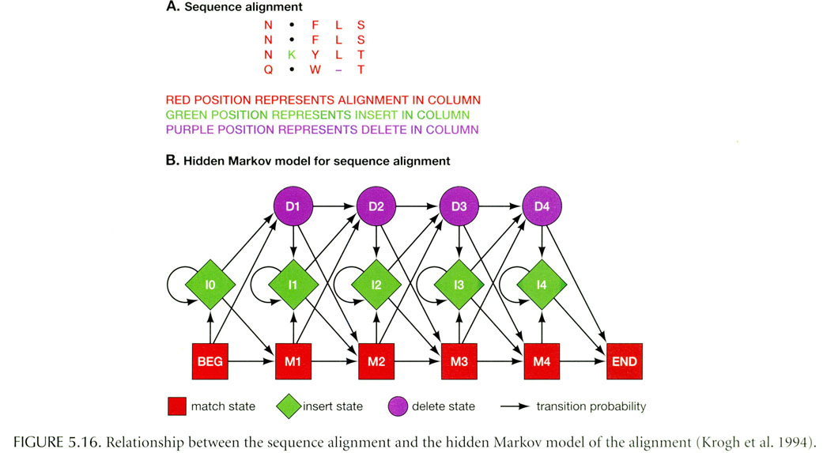
Hidden Markov Model (HMM)

Slide 59
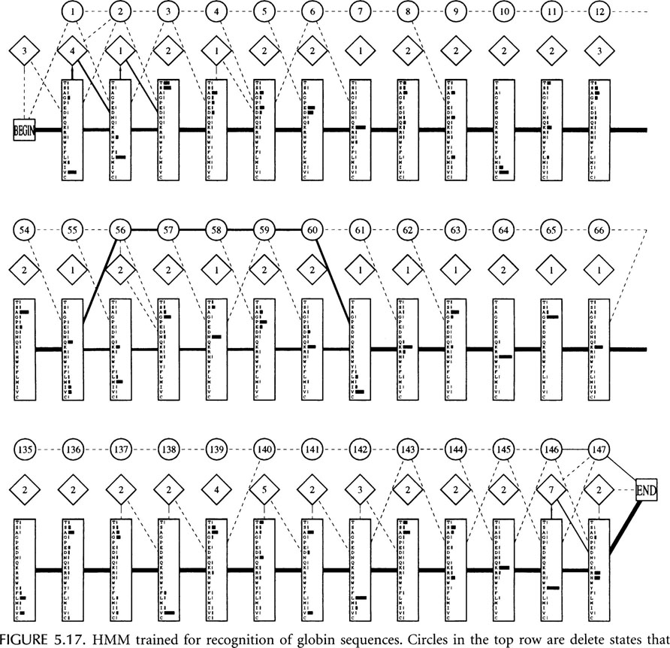

Slide 60
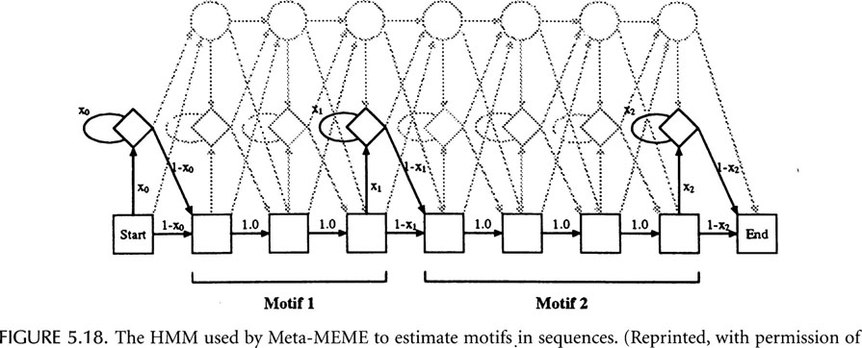

Slide 61
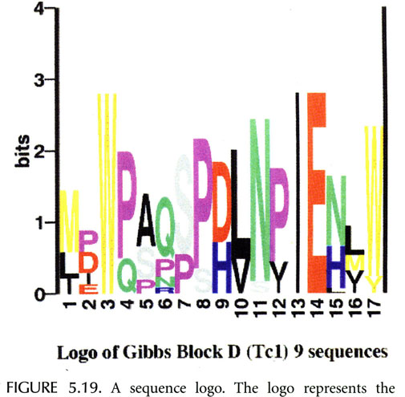
Position Specific Scoring Matrix (PSSM)

Slide 62
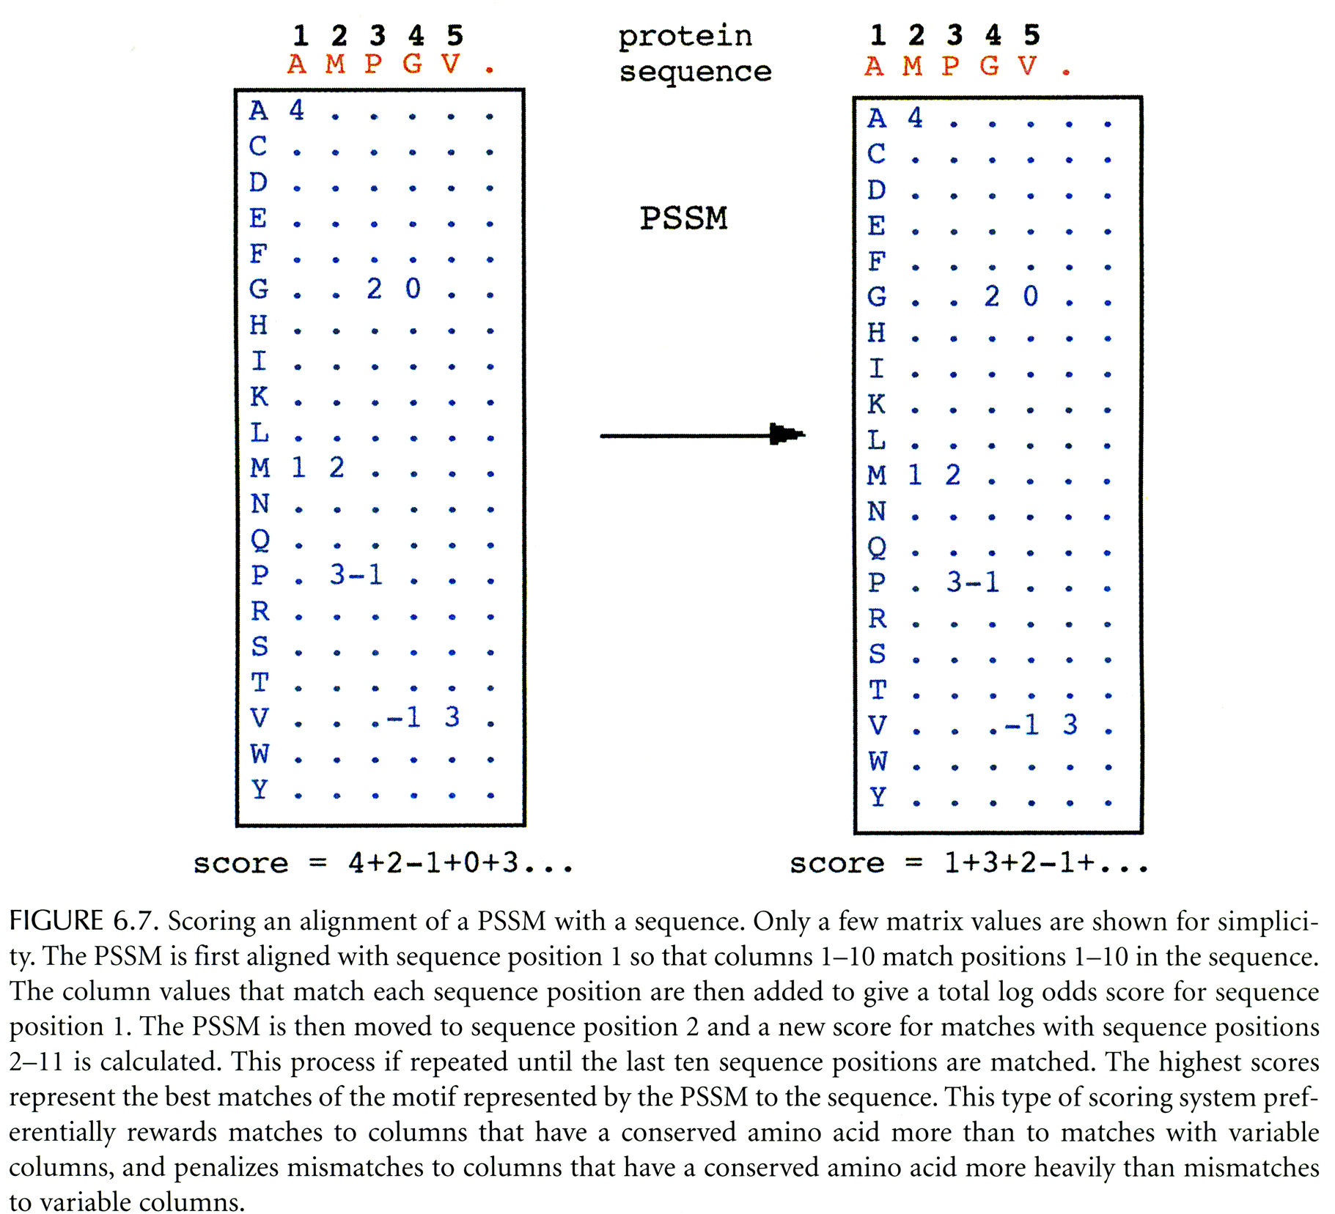
Scoring a PSSM with a sequence

Slide 63
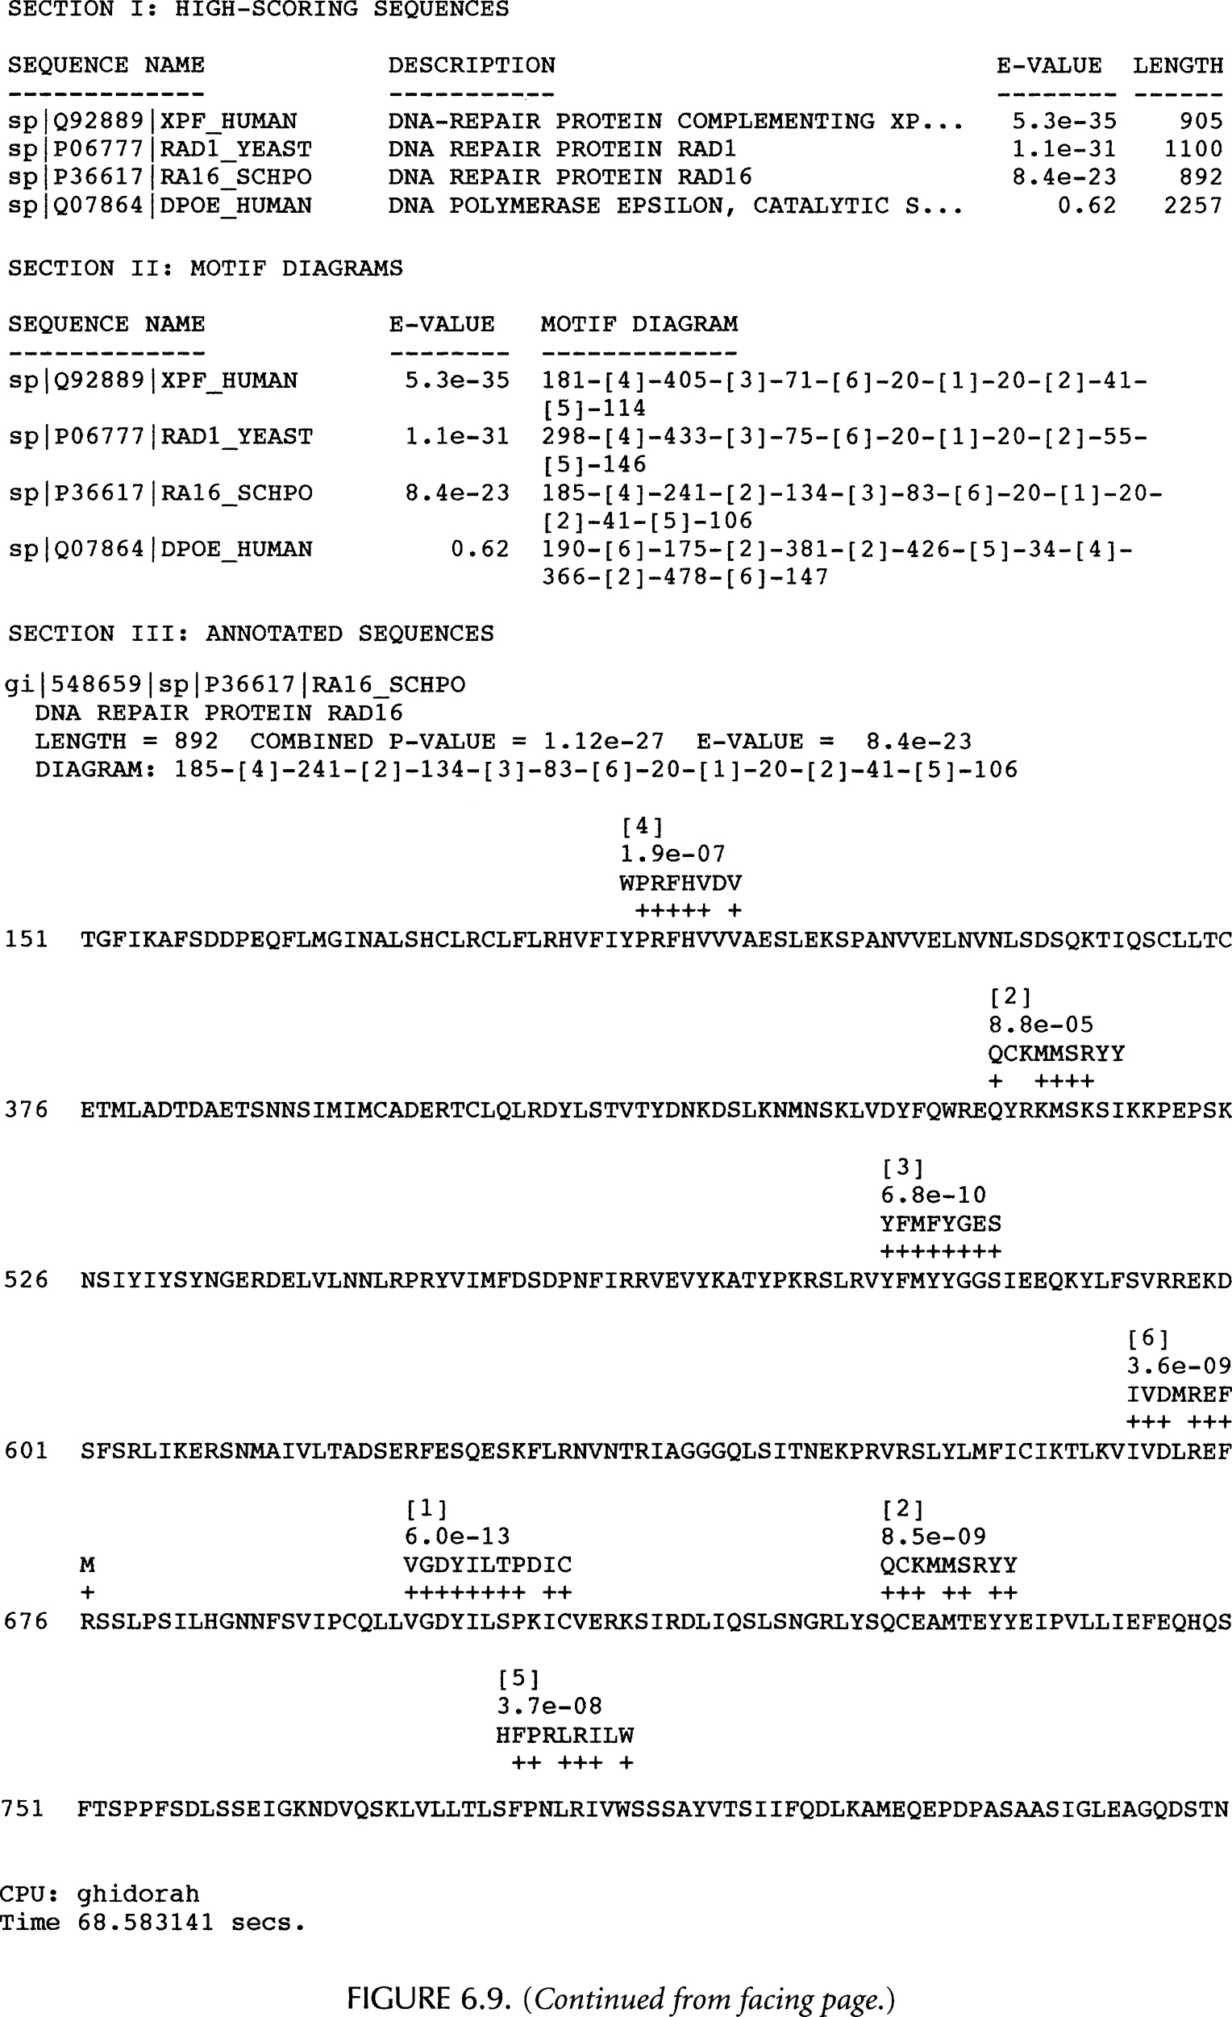

Slide 64
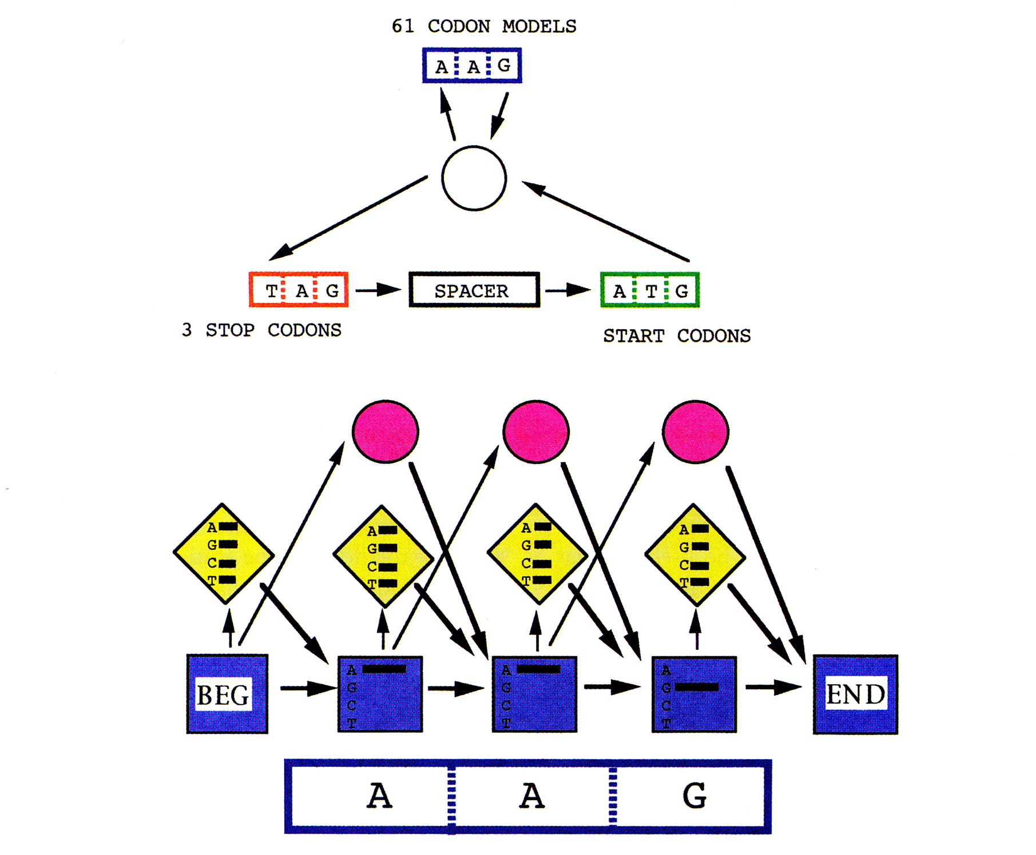
Hidden Markov Model for Gene Finding

Slide 65
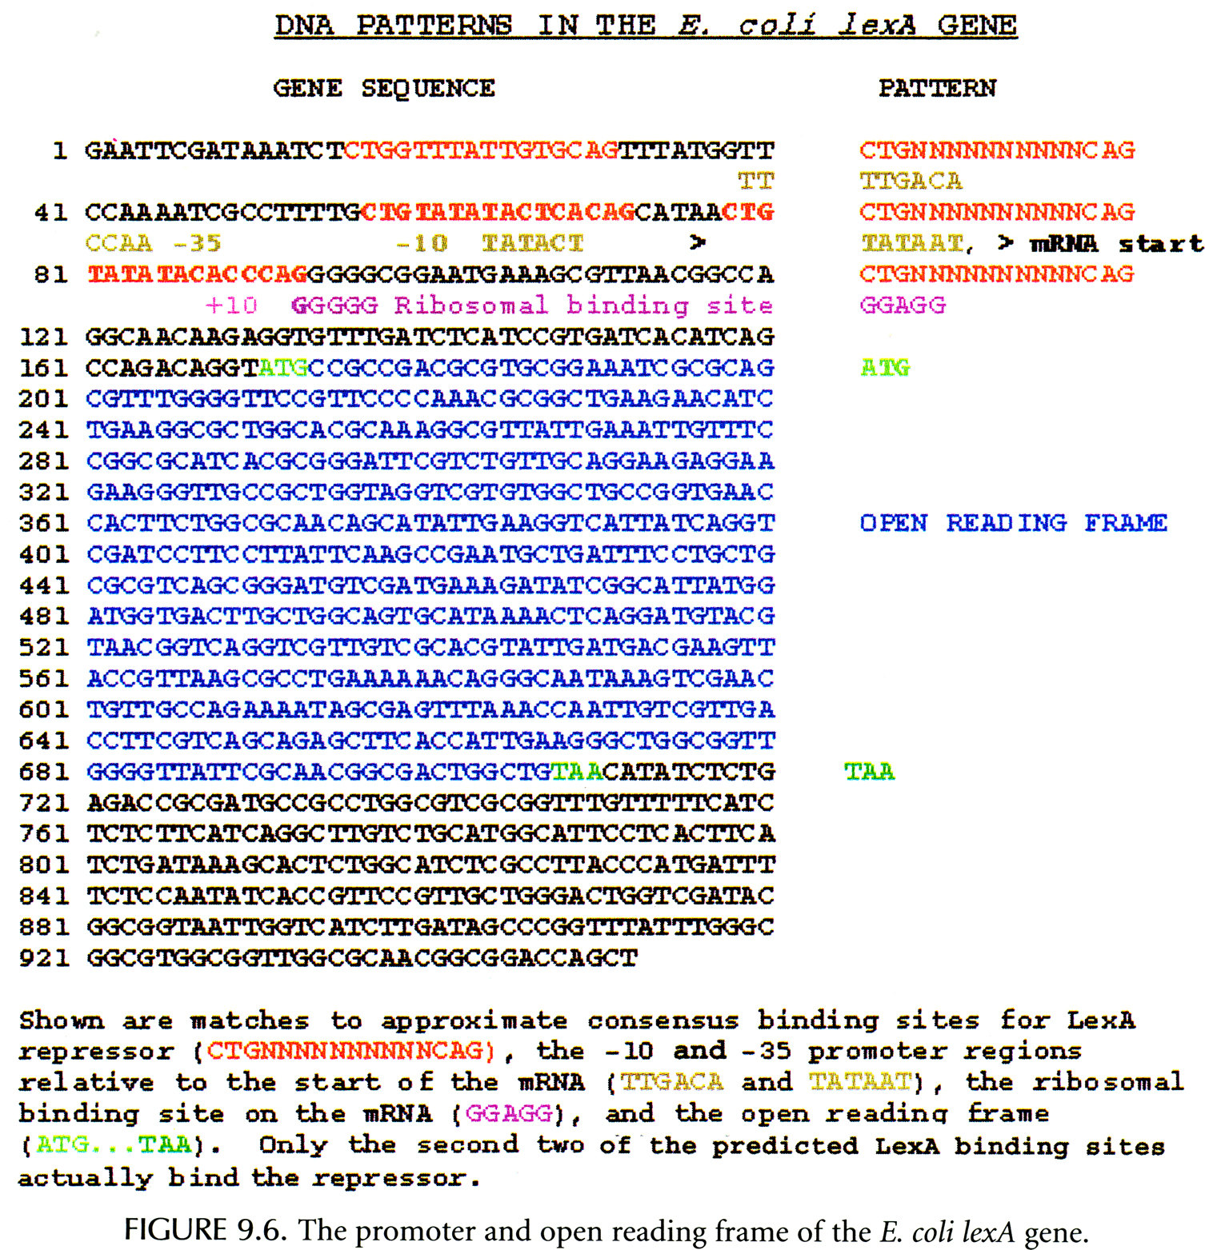

Slide 66
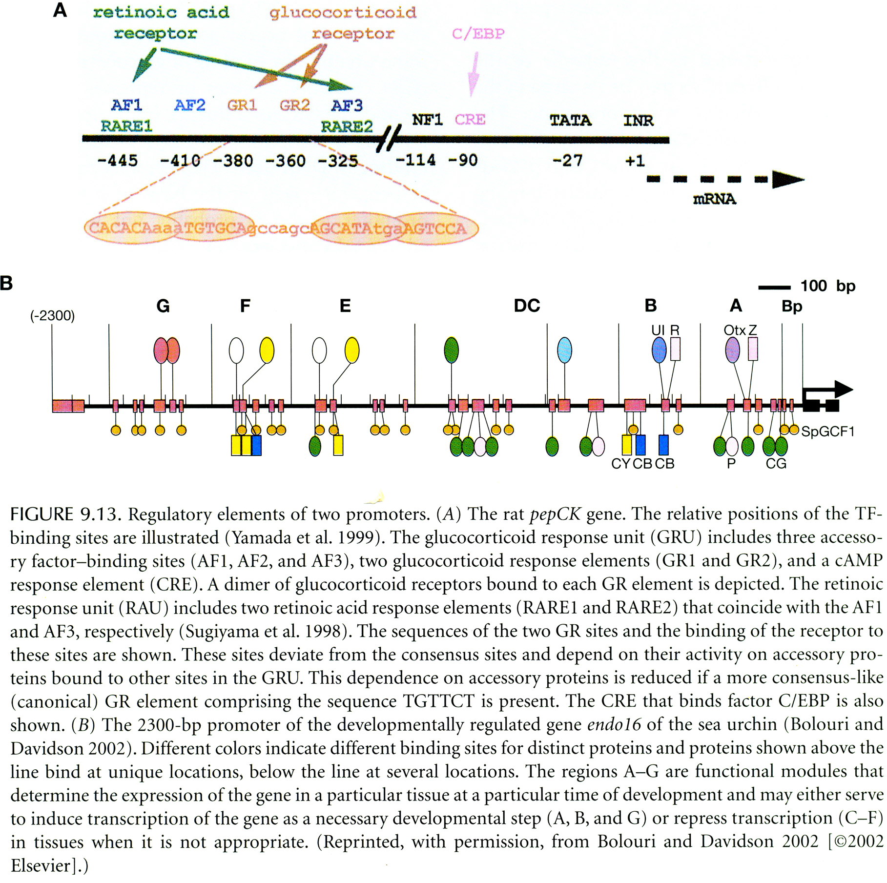
Promoter Analysis

Slide 67
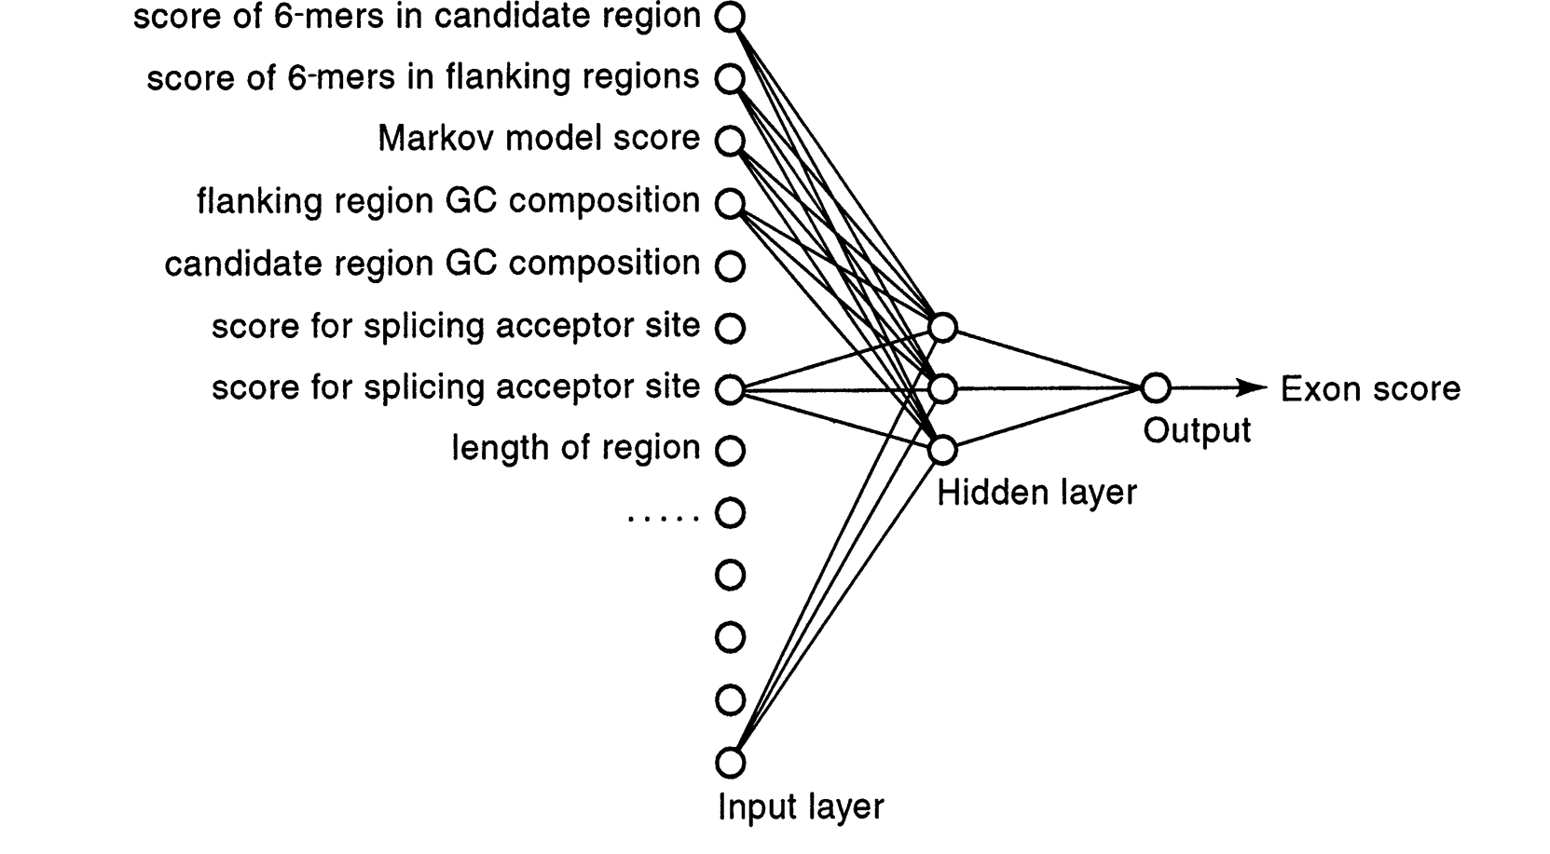
Neural Network for Gene Finding

Slide 68
实例一

Slide 69
Yan and Marr, Genome Res. 2005 Mar;15(3):369-75.

Slide 70
Introduction
The transcription of mRNA is coupled with 5’capping, splicing, and 3’ end formation.
3’ ends of most mature mRNA transcripts are polyadenylated with polyA tails.
The polyA tail is important for export from the nucleus, stability, and translation of the mRNA transcript.
Notes:
histone mRNAs are not polyadenylated.

Slide 71
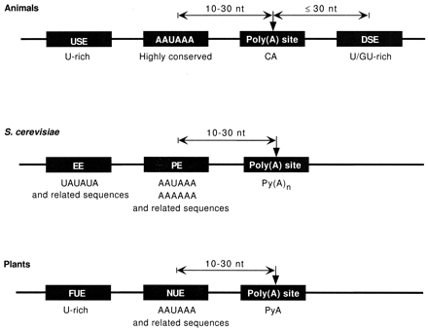
Polyadenylation elements on premature mRNA
Notes:
AAUAAA has variants like AUUAAA

Slide 72
Cleavage/polyadenylation machinery
Cleavage/polyadenylation specificity factor | CPSF | Cleavage and polyadenylation
Cleavage-stimulatory factor | CstF | Cleavage
Cleavage factors | CFI_{m}, CFII_{m} | Cleavage
RNA polymerase II | Pol II | Cleavage
polyA polymerase | PAP | Polyadenylation
polyA binding protein | PABII | Polyadenylation

Slide 73
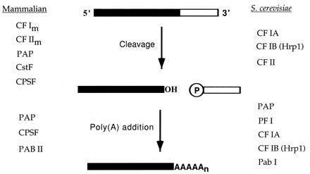

Slide 74


Slide 75


Slide 76
Alternative polyadenylation
Multiple polyA sites for a single gene.
Tissue-specific usage of alternative polyA sites.
Coupled with alternative initiation and splicing to generate transcript complexity.
It is usually considered to generate multiple 3’ UTRs for a single gene.

Slide 77

Three types of alternative polyadenylation
Edwalds-Gilbert, G., Veraldi, K.L., and Milcarek, C. 1997. Alternative
poly(A) site selection in complex transcription units: means to an end?
Nucleic Acids Res. 25: 2547-2561.
Notes:
Edwalds-Gilbert et al. surveyed experimental evidences and identified three types of alternative polyadenylation.

Slide 78

Notes:
CGRP is a neuropeptide.
In immature B cell, two forms of IgM are produced in equal amounts. While in terminal differentiated plasma cell, there is a shift from membrane form to secretory form.
The classical example of type II polyA sites is Immunoglobin M (IgM) heavy chain. There are two forms of IgM transcripts: membrane-bound form and secretory form. The membrane-bound form uses the distal polyA site in M 2 exon. The secretory form uses the proximal polyA site hidden in intron between exon Cμ 4 and M 1 exons. In immature B cells, the two forms have equal abundance. In terminally differentiated plasma cells, the secretory form is predominant. The classical example of type III polyA sites is calcitonin/CGRP. The use of polyA site at exon 4 gives rise to calcitonin in thyroid cells and most other cell types. In neuronal cells, exon 4 is skipped and poly-adenylated at exon 6. This gives a neuropeptide, CGRP.

Slide 79
Can we use computational analysis to systematically identify these three types of alternative polyadenylation?

Slide 80
EST and full-length cDNA
EST and full-length cDNA are two major sources of mRNA sequences.
ESTs provide deeper sampling of transcriptome.
3’ ESTs with polyA tails are abundant in dbEST database.
EST is only mRNA fragment. It is difficult to associate it to the proper gene.
Full-length cDNA has limited coverage but can be used as reference of the transcribed region in the genome.

Slide 82
Data source
20,860 (human), 16,743 (mouse), and 4,843 (rat) mRNA sequences were extracted from the NCBI RefSeq database release 4.
Human (build 34), mouse (build 32), and rat (build 2) genomes were downloaded from NCBI.
We downloaded ESTs of human, mouse, and rat from NCBI dbEST database (08 April 2004 release). We parsed ESTs with putative polyA tails.

Slide 83
Alignment procedures
mRNA and polyA EST sequences were repeat masked by RepeatMasker prior to the alignment.
mRNA and polyA EST sequences were aligned to the genomic sequences rapidly by megablast program.
The exon-intron boundaries were further identified using sim4 program.
The longest aligned RefSeq sequence is chosen as the reference sequence for each transcription unit.
polyA ESTs with the putative internal priming sites were removed.

Slide 84


Slide 85
Classification of polyA ESTs
Class I , the 3’ end of the EST falls within or downstream of the 3’ terminal exon of the reference sequence.
Class II, the 3’ end of the EST falls in the intron of the reference sequence and the 3’ terminal exon of the EST overlaps with the internal exon of the reference sequence.
Class III, the 3’ end of the EST falls in the intron of the reference sequence but the 3’ terminal exon of the EST does not overlap with any exon of the reference sequence.
Class IV, the 3’ end of the EST falls in the internal exon of the reference sequence.

Slide 86
Identification of polyA site
The 3’ ends of the polyadenylated transcripts were known to fluctuate within a small distance after the polyA signals.
The 3’ ends of the polyA ESTs on the genomic sequence were clustered if they were less than 50 bps apart.
The clusters of the 3’ ends of polyA ESTs were identified as the polyA sites.
Notes:
Fluctuate 10~15bps

Slide 88
Table 3. The abundance of transcription units in human, mouse, and rat.
The percentages of alternative polyadenylation are calculated relative to
the polyadenylated transcription units.
Notes:
Hidden exon is essentially skipped exon in Edwarlds-Gilbert’s paper.

Slide 89
Tandem polyA sites
Rhodopsin has tandem polyA sites. We found five (human), six (mouse), and four (rat) class I polyA sites in rhodopsin. All of them are downstream of the stop codon of the reference sequence. Transcripts using these polyA sites have different 3’ UTRs but encode the same protein. Three of the polyA sites are highly conserved across human, mouse, and rat.

Slide 90
Notes:
Upward triangles represent 3’ splice sites, downward triangles represent 5’ splice sites, and stars represent the polyA sites (big stars represent polyA sites with canonical polyA signals). Stop symbols represent stop codons.

Slide 91
Composite exon
Lamin A/C has a composite exon. Two polyA sites are present in human, mouse, and rat. When the transcript uses the promoter-distal polyA site in exon 12, it gives rise to Lamin A mRNA.
When the transcript uses the promoter-proximal polyA site hidden in the intron of Lamin A mRNA between exon 10 and 11, it gives rise to Lamin C mRNA. When translated into proteins, Lamin A has a different C-terminal domain from Lamin C.

Slide 92
Lamin A has a CaaX box (C, cysteine; a, aliphatic; X, any amino acid) in the C-terminal domain. Isoprenylation of the cysteine residue of the CaaX box is essential for lamin attachment to the inner nuclear membrane.
Lamin C lacks the CaaX box and requires the presence of other lamins for nuclear envelope attachment.
Notes:
In mouse and rat, there is a third isoform Lamin C2 (Alsheimer et al. 2001). Like Lamin C, it uses the promoter-proximal polyA site but has alternative 5’ terminal exon (alternative initiation). In human, there is also a third isoform Lamin Adel10. Like Lamin A, it uses the promoter-distal polyA site but skips exon 10 (alternative splicing).

Slide 93
Lamin A/C
human
52
8
34
mouse
5
1
5
rat
14
8
6

Slide 94
Hidden exon
Cell Division Cycle 42 (CDC42) has a hidden exon. We found six (human), five (mouse), and five (rat) polyA sites in CDC42.
With the exception that one polyA site appears to be human-specific, all of the other five polyA sites are conserved among human, mouse, and rat.

Slide 95
Polyadenylation at three (four in human) promoter-distal polyA sites leads to the transcripts encoding protein isoform 1.
Polyadenylation at the other two promoter-proximal polyA sites leads to the transcripts encoding protein isoform 2. These two protein isoforms have the exactly same lengths but differ in their last 10 C-terminal amino acids. Whether this leads to different functions of the two protein isoforms is worth further investigation.

Slide 96
CDC42
human
4
2
4
10
5
1
48
mouse
6
13
2
11
2
50
rat
5
3
2
7
3
14

Slide 97
Truncated exon
WW domain binding protein 2 (Wbp2) has a truncated exon in rat but not in human or mouse. 67 (human), 31 (mouse), 14 (rat) polyA ESTs use a conserved class I polyA site. Only one rat polyA EST uses a class IV polyA site within the last internal exon of the reference sequence.
This polyA EST truncates the coding sequence before it reaches the stop codon. No canonical polyA signals (AATAAA and ATTAAA) or their variants are found near the polyA site.

Slide 98
Protein-coding capacity
Most of class I polyA sites (99% in human) fall downstream of the stop codon of the reference sequence. They share the stop codon with the reference sequence and encode the same protein.
Most of class IV polyA sites (87% in human) fall between the start and stop codons of the reference sequence on the genome. These class IV ESTs truncate the coding exon of the reference sequence and lack the stop codon.
Class II and III ESTs may have stop codons hidden in the introns of the reference sequence.

Slide 99
Presence of stop codons | Class II polyA sites | Class III polyA sites
Human | 81% | 88%
Mouse | 73% | 84%
Rat | 79% | 89%

Slide 100
Non-coding RNA
If not experimental artifacts, most of class IV ESTs and a small portion of class II and III ESTs can only be non-coding transcripts. Non-coding transcripts have been shown to exist extensively in human (Cawley et al. 2004). They can simply be the mistakes made by the transcription machinery and undergo the degradation soon after the transcription, or they can have important regulatory functions (Martens et al. 2004 and Cawley at al. 2004).

Slide 101
Polyadenylation efficiency
We define the polyadenylation efficiency of the polyA site as the number of polyA ESTs using the polyA site.
In human, the average polyadenylation efficiencies are: 14.53 (class I), 2.65 (class II), 3.09 (class III), and 2.00 (class IV).
In all three species, we found that the average polyadenylation efficiencies follow the same order: class I > class III > class II ≈ class IV.
Notes:
Some polyA sites are used more often and associated with a large number of polyA ESTs. The others are used more rarely and associated with only one or a few polyA ESTs.

Slide 102
Distance effect on polyadenylation
Polyadenylation efficiency is proportional to the distance between promoter and polyA site. (Class I is the largest)
Polyadenylation efficiency is also proportional to the distance between 5’ splice site and polyA site (Class III > Class II > Class IV).
Complicated interaction between splicing and polyadenylation machineries during the mRNA post-transcriptional processing.

Slide 103

Notes:
Class II, competition between U1 binding 5’ss and CPSF binding polyA signal.
Class III, competition between splicing at upstream 3’ss or downstream 3’ss.
Class II is often inefficient. Inserting a polyA site into an intron is often ignored.
The order of splicing and polyadenylation is not clear today.

Slide 104
Conservation of polyA site
Preliminary comparison between human, mouse, and rat shows significant changes in polyA site. The length of 3’ UTR often varies a lot across human, mouse, and rat.
Primary polyA sites are often more conserved.
Only small portions of class II, III alternative polyadenylation patterns are highly conserved including Lamin A/C (class II), CDC42 (class III), Nucleophosmin (class III), Olfactomedin 1 (class III).

Slide 105


Slide 106


Slide 107
Conclusion
Alternative polyadenylation is prevalent in mammalian genomes.
Four classes of alternative polyadenylation are distinct in their splicing-polyadenylation patterns, protein-coding capacities, and polyadenylation efficiencies.
Strong evidences including full-length mRNA sequences and protein sequences exist for class I, II, and III transcripts. But the role of class IV transcripts remains elusive.

Slide 108
Exon truncated by Polyadenylation has a function!
Yao et al., Cell. 2012 Mar 30;149(1):88-100.

